Slide 1
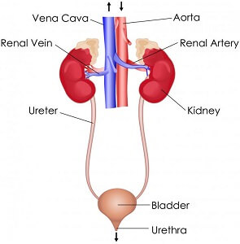
Anatomy
Two kidneys
Two ureters
Urinary bladder
urethra

Slide 2
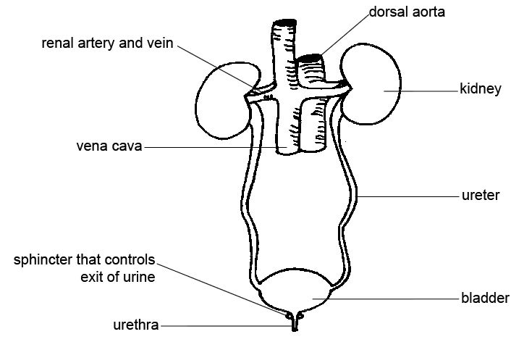
Function
Urinary system function
1- remove liquid waste from blood
2- maintain acid balance in body
3- maintain fluid balance in body
4- control blood volume
5-formation of urine

Slide 3
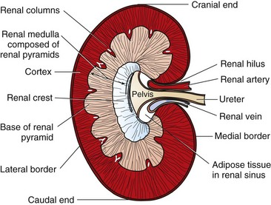
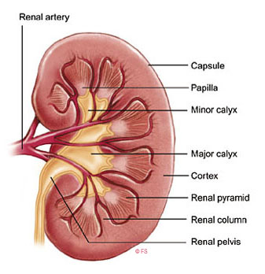
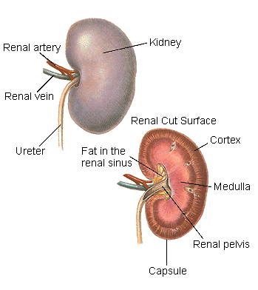
Anatomy
■ The kidneys lie in the retroperitoneal space lateral to the aorta and the caudal vena cava. They have a fibrous capsule and are held in position by subperitoneal connective tissue.

Slide 4
Definitions
■ Chronic kidney disease (CKD): refers to patients with markers of structural or functional kidney damage of longer than 3 months’ duration.
■ Acute renal failure (ARF) may also be referred to as acute kidney injury (AKI) and refers to patients that have an abrupt decline in renal function usually caused by an ischemic, toxic, or infectious insult.
■ Chronic renal failure (CRF) refers to patients with CKD with significant clinical signs (polyuria, polydipsia, weight loss, decreased appetite) and laboratory findings (azotemia, anemia, proteinuria).

Slide 5
laboratory findings
■ The minimum database for patients with urinary dysfunction includes measurement of :
- hematocrit,
- blood urea nitrogen (BUN),
- phosphorus, calcium,
- creatinine,
- total protein, albumin, magnesium, electrolytes,
- total carbon dioxide levels, urinalysis,
- blood pressure, and an electrocardiogram

